Slide 1
Heaps and Priority Queues
EECS 233

Slide 2
Queue ADT Revisited
A queue is a sequence in which:
  items are added at the rear and removed from the front
    first in, first out (FIFO) (vs. a stack, which is last in, first out)
  we can only access the item that is currently at the front
Operations:
  boolean insert(T item); add an item at the rear of the queue
  T remove(); remove the item at the front of the queue
  T peek(); get the item at the front of the queue, but don’t remove it
  boolean isEmpty(); test if the queue is empty
  boolean isFull(); test if the queue is full

Slide 3
Priority Queues
A priority queue is a collection of items, each of which has an associated priority (a number).
  Applications?
Operations:
  insert: add an item to the priority queue (with a priority value)
  remove: remove a highest-priority item
    an item in the queue with the largest associated priority value
  …
How can we efficiently implement a priority queue?
  Unsorted list, sorted list, sorted array?
  AVL-tree?
  (A new type of binary tree known as a heap)

Slide 4

Tree Types and Characteristics
Structural constraints
  Constraints on number of children
    Binary trees (at most 2 children)
    B-trees (between M/2 and M children)
  Balance constraints
    Binary search trees - unconstrained
    AVL-trees - differ in subtree heights by at most 1
Key order constraints
  Binary search trees and AVL trees
≤

Slide 5
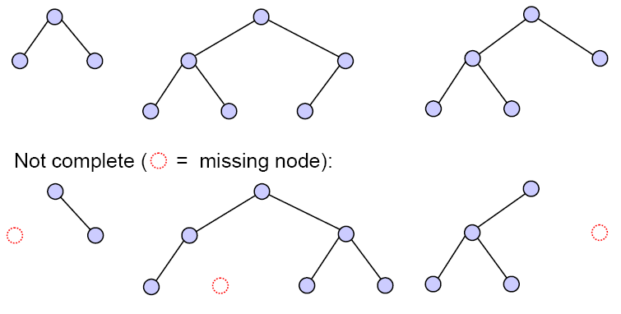
Structure Types of Binary Trees
Full binary trees
  Every node has exactly two or zero children
Perfect binary trees
  Full trees with all leafs at the same depth
Complete binary trees
  Balanced, and at the same level, filled left to right
Complete:

Slide 6
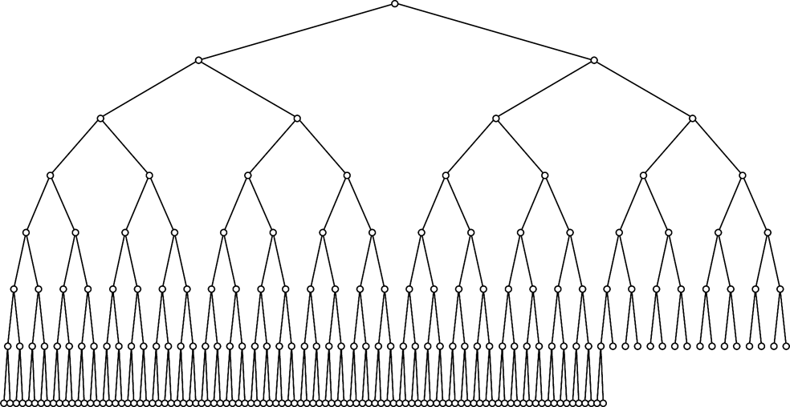
A Large Complete Binary Tree

Slide 7
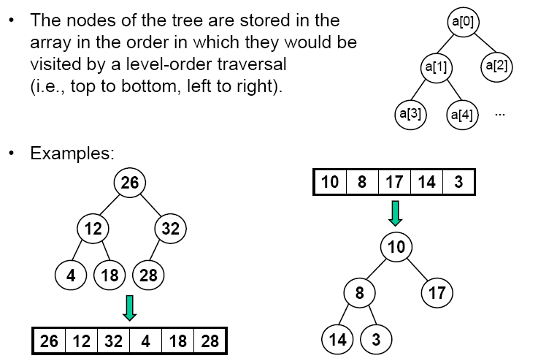
Array Representation of A Complete Binary Tree
A complete binary tree has a simple array representation.
The nodes of the tree are stored in the
array in the order in which they would
be visited by a level-order traversal
(i.e., top to bottom, left to right).

Slide 8
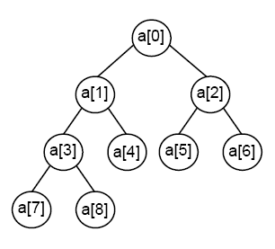
Navigating in A Complete Binary Tree
The root node is in a[0]
Given the node in a[i]:
  its left child is in a[2*i + 1]
  its right child is in a[2*i + 2]
  its parent is in a[(i – 1)/2], i!=0
Examples:
  the left child of the node in a[1] is in a[2*1 + 1] = a[3]
  the right child of the node in a[3] is in a[2*3 + 2] = a[8]
  the parent of the node in a[4] is in a[(4–1)/2] = a[1]
  the parent of the node in a[7] is in a[(7–1)/2] = a[3]
A[0]
A[1]
A[2]
A[3]
A[4]
A[5]
A[6]
A[7]
A[8]

Slide 9
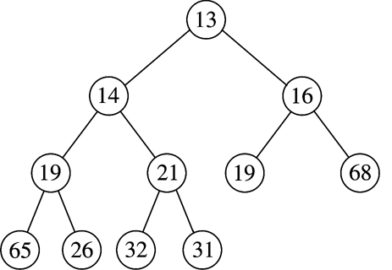
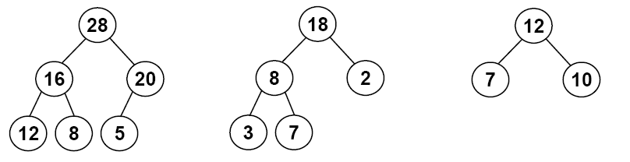
Heaps for Priority Queues
A complete binary tree
  The only ordering constraint: a node’s key >= keys of children (if any)
The largest value is always at the root of the tree.
The smallest value can be in any leaf node – there’s no guarantee about which one it will be.
These are max-at-top heaps.
One can also define a min-at-top heap, in which every interior node is less than or equal to its children.

Slide 10
Heap ADT - Generics
We want a heap that can store data items of different types (just like generic lists, stacks, and queues)
  A “priority” can be a more general concept than a “search key”
  We would like to derive “priority” from the object rather than have a distinct “key” attribute
Writing a generic heap (as well as BST and AVL trees) is somewhat tricky: we need to make sure that we can compare the data items.
  if (item1 < item2)
  …
Problem
  In Java, if item1 and item2 refer to objects, the condition above will compare the memory locations of objects, not the actual items of the objects.

Slide 11
Generic Heaps – Comparable Objects in Java
To compare objects in Java, we need to use a method called compareTo().
  many built-in classes have a version of this method, e.g., String, Integer, Double, etc.
  we can define a version of this method in classes that we write
    public int compareTo(Classname other)
Then, o1.compareTo(o2) should return:
  a negative integer, e.g., -1, if o1 is less than o2
  0 if o1 equals o2
  a positive integer, e.g., +1, if o1 is greater than o2
We also should indicate that our class has this method by adding the following to the class header:
    class Classname implements Comparable<Classname>

Slide 12
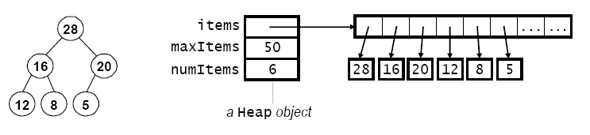
Generic Heaps in Java
public class Heap<T extends Comparable<T>> {
  private T[] items;
  private int maxItems;
  private int numItems;
  public Heap(int maxSize) {
    items = (T[])new Comparable[maxSize];
    maxItems = maxSize;
    numItems = 0;
  }
  …
}
Suitable for objects of any type T that has a compareTo() method and contains “implements Comparable<T>” in its class header. The array actually stores the references

Slide 13
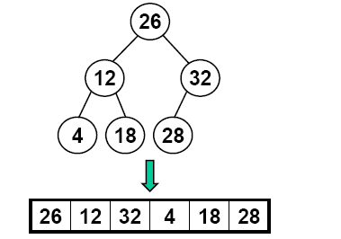
Removing An Item (the largest)
Remove and return the item in the root node.
  In addition, we need to move the largest remaining item to the root, while maintaining a complete tree with each node >= children
23
3
18
18
12
4
3
23
18

Slide 14

Removing An Item (the largest)
Remove and return the item in the root node.
  In addition, we need to move the largest remaining item to the root, while maintaining a complete tree with each node >= children
Method:
  make a copy of the largest item
  move the last item in the heap to
  the root
  “sift down” the new root item until
  it is >= its children (or it’s a leaf)
  return the largest item
“sift”: items are filtered such that small ones will fall

Slide 15
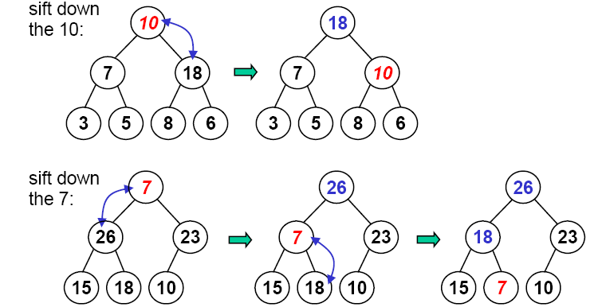
“Heapify” – Sifting Down
To sift down item x (i.e., the item whose key is x):
  compare x with the larger of the item’s children, y
  if x < y, swap x and y and repeat

Slide 16
SiftDown Method
private void siftDown(int i) { // Input: the node to sift
  T toSift = items[i];
  int parent = i;
  int child = 2 * parent + 1; // Child to compare with; start with left child
  while (child < numItems) {
    // If the right child is bigger than the left one, use the right child for comparison.
    if (child +1 < numItems && // if the right child exists
      items[child].compareTo(items[child + 1]) < 0) // … and is bigger than the left child
        child = child + 1; // take the right child
    if (toSift.compareTo(items[child]) >= 0)
      break; // we’re done
    // Sift down one level in the tree.
    items[parent] = items[child];
    items[child] = toSift;
    parent = child;
    child = 2 * parent + 1;
  }
  items[parent] = toSift;
}
We don’t have to put sifted item in place of child. We can wait until the end to put the sifted item in place.
7
26
23
15
18
10
26
7
23
15
18
10
26
18
23
15
7
10

Slide 17
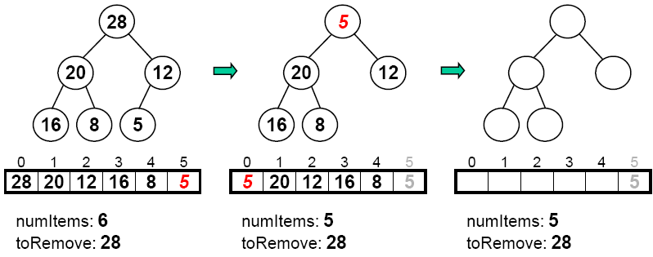
RemoveMax Method
public T removeMax() {
  T toRemove = items[0];
  items[0] = items[numItems-1];
  numItems--;
  siftDown(0);
  return toRemove;
}

Slide 18
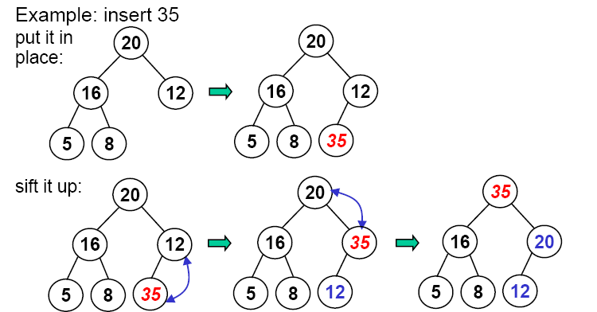
Inserting An Item
Algorithm:
  put the item in the next available slot (grow array if needed)
  “sift up” the new item until it is <=its parent (or becomes the root)

Slide 19
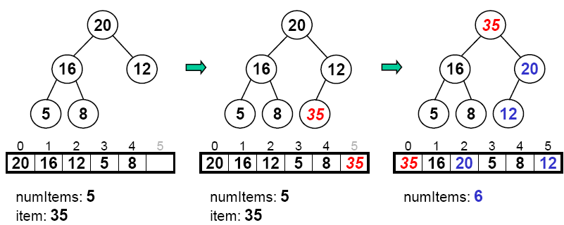
Insert Method
public void insert(T item) {
  if (numItems == maxItems) {
    // code to grow the array goes here…
  }
  Items[numItems] = item;
  numItems++;
  siftUp(numItems-1);
}

Slide 20
Running Time of Insert / Remove
Insert() / RemoveMax()
SiftUp and SiftDown
  Height h = log₂N
  Running time O(log₂N) in the worst case
Both insert and remove (max at the root) are fast
But search is inefficient due to limited ordering information

Slide 21

Binary Heaps and Tournament Trees
A field of 2^{h} players (teams), each with a strength value
A player with a higher strength value will win and advance to the next round; the loser goes home (playoff events, e.g., baseball)
Limited ordering information: we can only tell who is the champion; the runner-up may not be the second best player.
8
8
5
7
8
2
5
6
7
6
8
2
1
4
5

Slide 22
Building A Heap – A Naïve Algorithm
Take N items from an array and build a heap.
Naïve algorithm
  For each item, insert it into a heap, which is initially empty
  public void buildHeap(T[ ] array, int size )
  {
  < initialize the heap here …>
  for( int i = 0; i < size; i++ )
  insert(array[i]);
  }
  Running time: O(log(1) + log(2) + … + log(N)), or O(NlogN)

Slide 23
An Efficient Algorithm: Build the Heap in Place
  1. Position = (numItems-2)/2; // initial position – the parent of the last item
  2. siftDown item at that position.
  3. Decrement position by one.
  4. Repeat steps 2,3,4 until position is 0.
  public void buildHeap( )
  {
  for( int i = (numItems -2)/2; i >= 0; i-- )
  siftDown( i );
  }
1
8
12
6
15
9
5
13
14
7
10
11
4
2
3
1
siftDown
starts here
8
12
6
15
9
5
Its parent
13
14
7
10
11
4
2
3
Last item

Slide 24
An Efficient Algorithm
  for( int i = (numItems -2) / 2; i >= 0; i-- )
  siftDown( i );
1
8
12
siftDown(3)
siftDown(4)
siftDown(5)
siftDown(6)
6
15
9
5
13
14
7
10
11
4
2
3

Slide 25
An Efficient Algorithm
  for( int i = (numItems -2) / 2; i >= 0; i-- )
  siftDown( i );
1
siftDown(1)
siftDown(2)
8
12
siftDown(3)
siftDown(4)
siftDown(5)
siftDown(6)
14
15
11
5
13
6
7
10
9
4
2
3

Slide 26
An Efficient Algorithm
  for( int i = numItems / 2 - 1; i >= 0; i-- )
  siftDown( i );
siftDown(0)
1
siftDown(1)
siftDown(2)
15
12
14
10
11
5
13
6
7
8
9
4
2
3

Slide 27
An Efficient Algorithm
  for( int i = numItems / 2 - 1; i >= 0; i-- )
  siftDown( i );
siftDown(0)
15
14
12
13
10
11
5
1
6
7
8
9
4
2
3

Slide 28
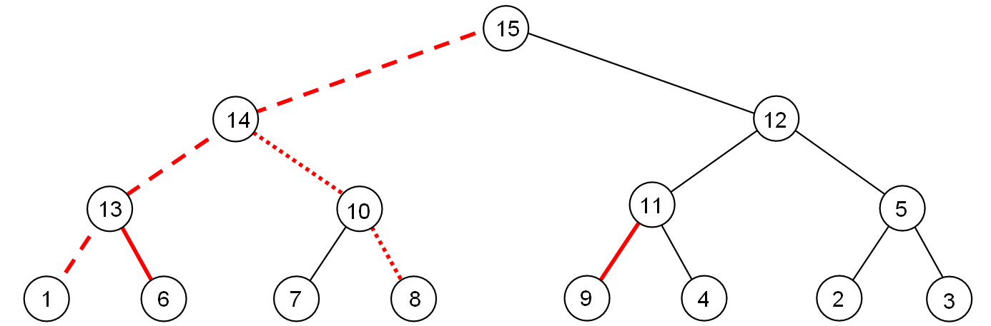
Running Time Analysis
O(NlogN) as siftDown() is called N/2 times, and each takes no more than O(logN) time.
However, this running time is not tight. The cost of BuildHeap is bounded by the number of red lines (all red lines)
  …which is at most the sum of heights of all nodes of the heap.
This sum is O(N), where N is the number of nodes in the heap.

Slide 29
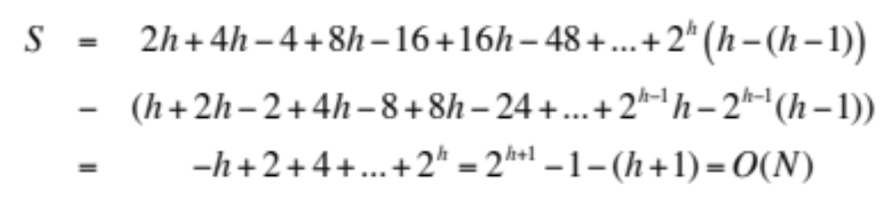
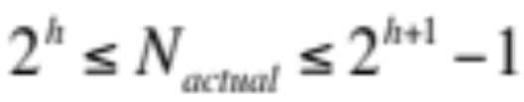
Running Time Analysis
For a perfect binary tree of height h, N = 2^{h+1}-1:
  1 node at height h
  2 nodes at height h-1
  4 nodes at height h-2
  …
  2^{h-1} nodes at height 1
  2^{h} nodes at height 0
  Total height of all nodes
Although a complete tree is not a perfect binary tree, but number of nodes in a complete tree of height h is:
Thus the actual number of nodes is within a factor of 2 of N. Hence, S = O(N_{actual})

Slide 30
Merge Two Heaps
Merge two heaps into a single one.
Append one heap to the end of the other, and then just like buildHeap, sift down the items (in the interior nodes)
  Running time = O(?)

Slide 31
Running Time of Binary Heap Operations
Summary of the worst-case running time of binary heap operations (max-at-top)
  findMax O(1)
  removeMax() O(logN)
  insert() O(logN)
  delete() O(logN)
  update() the priority O(logN)
  buildHeap() O(N)
  merge() O(N)
Average-case running time is
different for insertion. It takes
O(1) average time (about 2.6
comparisons)
unlikely
Even less likely
Less likely
More likely siftUp goes here

Slide 32
Etc.
Problem of the week:
  Assume that you want FIFO order within a given priority. Do heaps provide any guarantees in this regard? Why or why not?

